Slide 1


Slide 2
2nd Sprint
1ST SPRINT GOALS:

Slide 3
Nth Sprint
Recap
What is Val Uni?
VAL-UNI is an Information-based platform where students can share their experiences and exchange knowledge and feedback regarding professors and courses.

Slide 4
Second Sprint Objectives
Tasks Set
Tasks Done

Slide 5
Tasks Set
Create Review Page
Rating Boxes
Review Button
Hyperlinking
Creating Search Drop Menu
Link and activate the authentication
Have a functional Homepage
Create remaining queries for database organization
Tasks Done

Slide 6
Tasks Done
Review Page
Linking Review Page to Home Page
Fully functional login system
Creation of Queries
Database is hosted online
Tasks Set

Slide 7
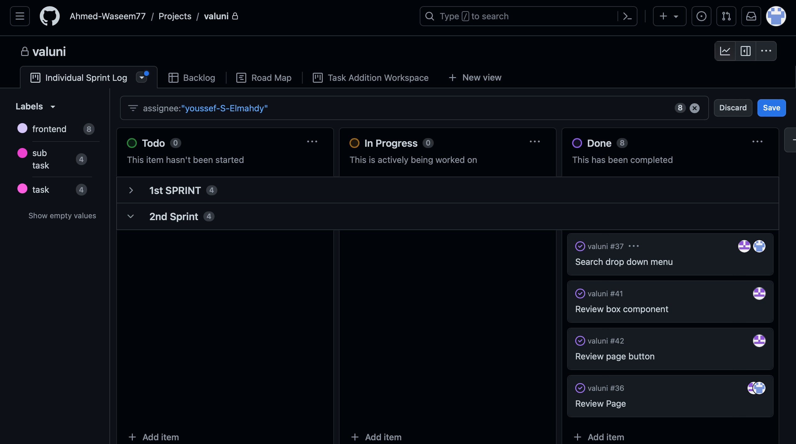
Sprint Board

Slide 8
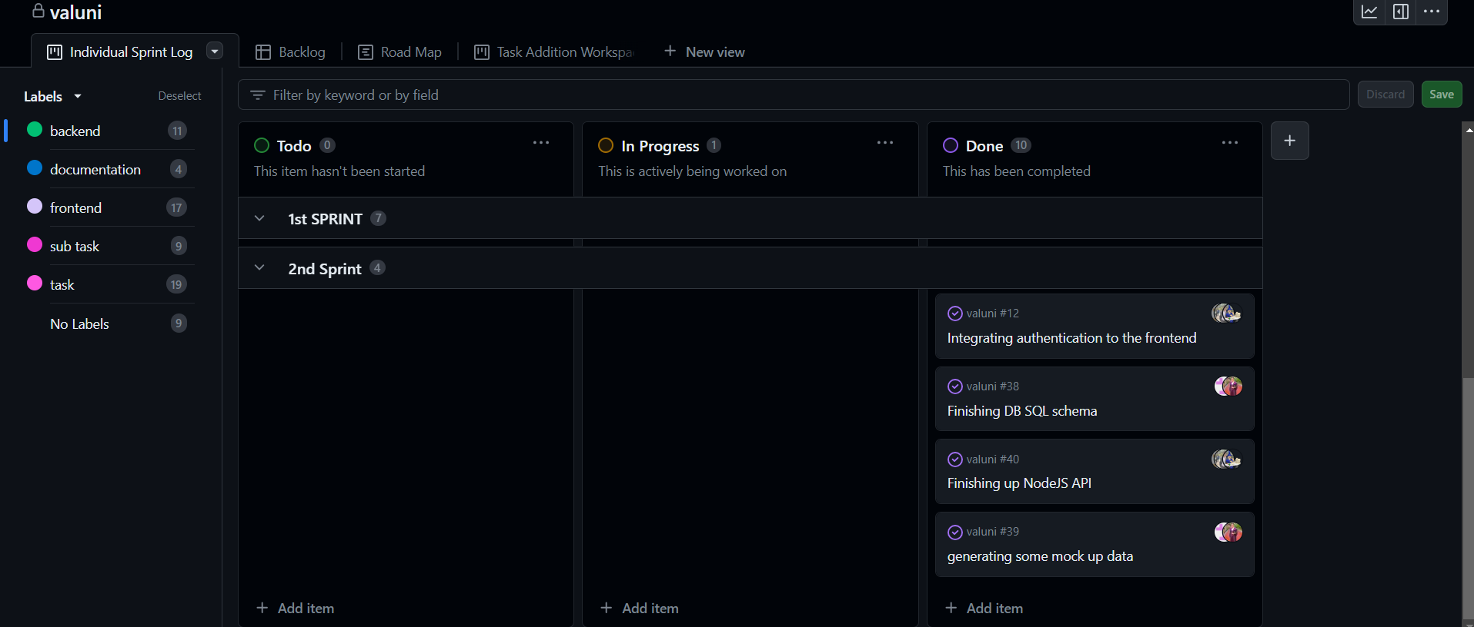
Sprint Board

Slide 9
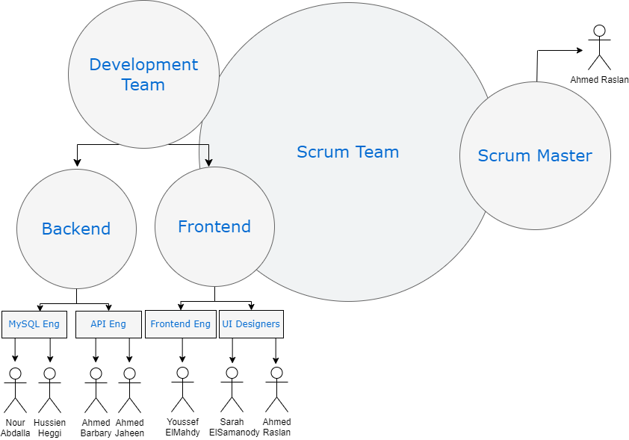
Scrum Methodology

Slide 10


Obstacles Faced
Styling Overlapping Components
Handling Queries
Database Linking
Timing & Multitasking

Slide 11
Obstacles Faced
Handling Queries
Database Linking
Timing & Multitasking
Styling Overlapping Components
We ran some bugs when it came
to creating some web components
Solution:
pair programming & maintain simplicity whenever we can through refactoring

Slide 12
Obstacles Faced
Database Linking
Timing & Multitasking
Styling Overlapping Components
Handling Queries
Maintaining the consistency between queries
Made sure all working members in this part familiar so no one would be working with their individual technique
Maintain simplicity wherever we can

Slide 13
Obstacles Faced
Timing & Multitasking
Styling Overlapping Components
Handling Queries
Database Linking
Debugging took so long
Solution:
Due to time constraints , we figured out the small bug and got authentication running
homepage linking with database will be up and running next sprint

Slide 14
Obstacles Faced
Styling Overlapping Components
Handling Queries
Database Linking
Timing & Multitasking
Juggling work , midterms & studying
Solution:
For this sprint we divided smaller and smaller tasks to be able to get as much done by the time of the deadline

Slide 15
What went better than previous sprint?
More familiar with front end technology so less dependency on scrum master.
Work was divided in a more practical way to handle priorities correctly.
Integration was faster due to pre existing components from previous sprint.
Focused on maintaining simplicity and continuous integration.

Slide 16
What will be done in following sprint?
Add more functionality to review pages
Deploying website online
The ability to edit and report reviews
University Data Analysis

Slide 17
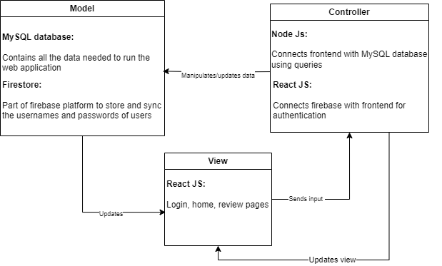
Architectural Pattern

Slide 18
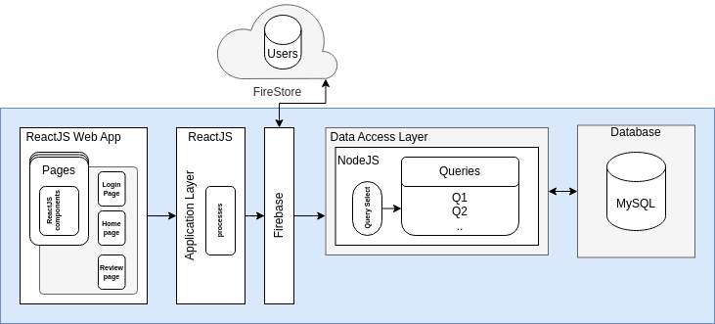
Detailed Architecture

Slide 19
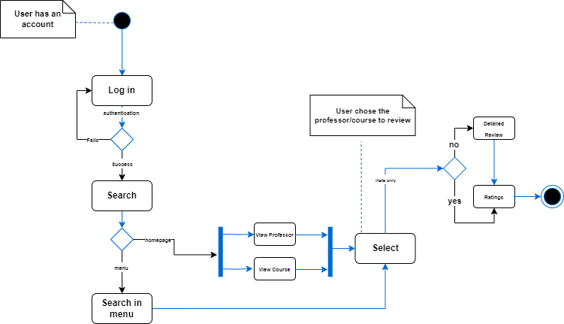
Activity Diagram for Writing a Review

Slide 20
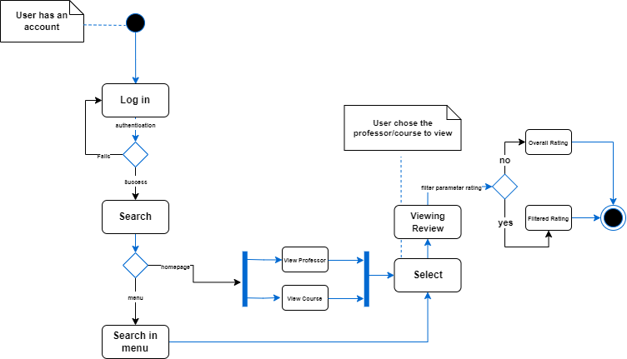
Activity Diagram for Reading a Review

Slide 21
THANK YOU!

